Slide 1
Android Installation

Slide 2
Required Installation Files
1. JDK
http://www.oracle.com/technetwork/java/javase/downloads/jdk6downloads-1902814.html
2. adt-bundle
http://developer.android.com/sdk/index.html
- Eclipse
- Android SDK

Slide 3
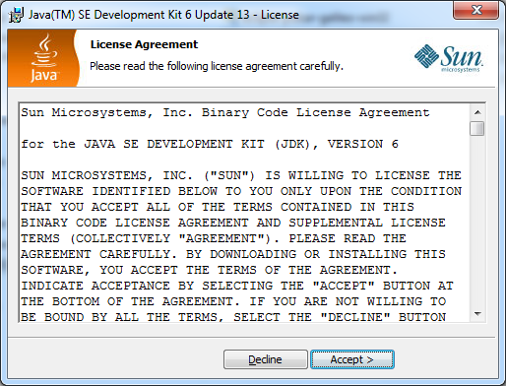
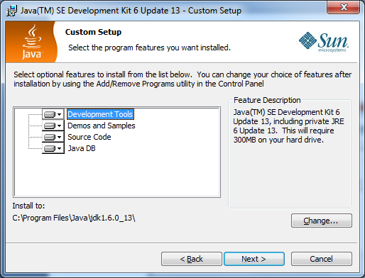
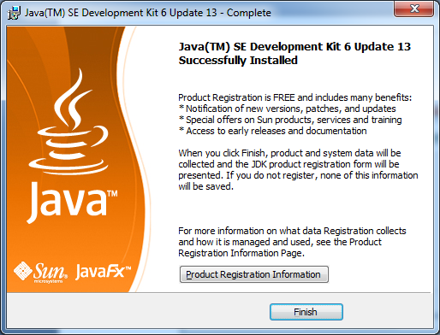
Step by Step for Android Installation
Step 1: Installing jdk
Run the jdk 6.3.1 by double clicking the jdk-6u13-javafx1_1_1-windows-i586.exe
Click on Accept to agree on licensing ->Next->Finish

Slide 4

Creating Android Virtual Device (AVD)
Select Window -> AVD Manager from the menu or
Select Android Virtual Device Manager icon from the standard toolbar
Click the New button to create an android emulator

Slide 5
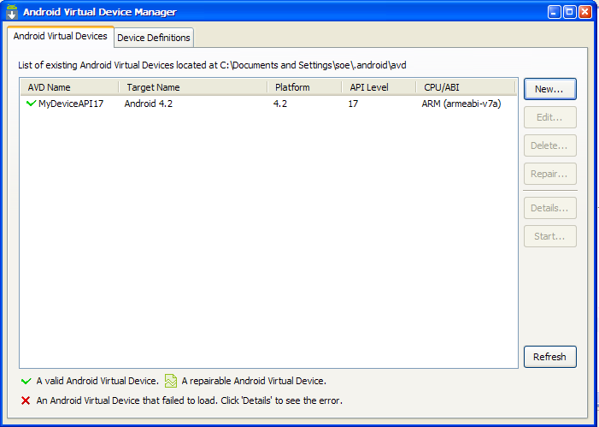

Slide 6
Enter the attributes of the Android Emulator
Name: Android Virtual Device Name or Emulator Name (Any Name)
Target : Android Version
SD card : size of SD card
Click the Ok button

Slide 7
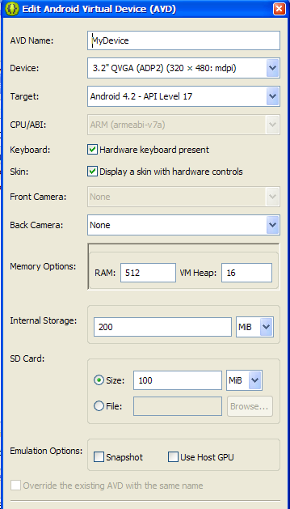

Slide 8
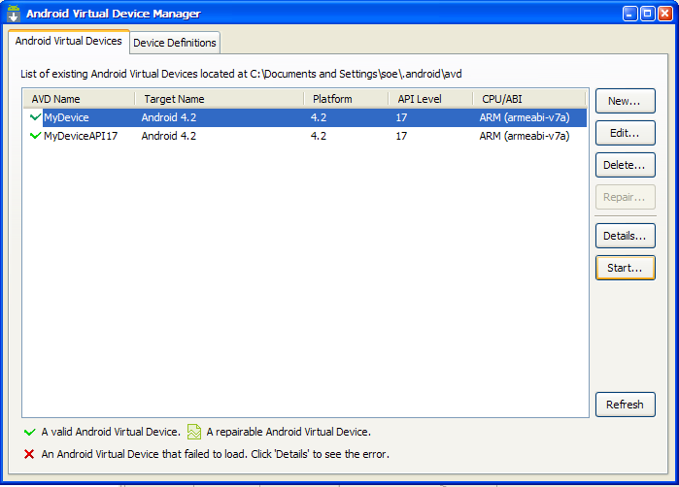
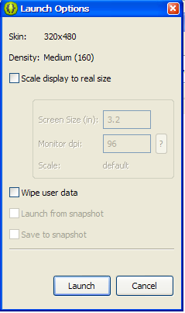
Select the AVD and then click the Start button
When the Launch Options Message box appears, press the Launch button to run the emulator

Slide 9
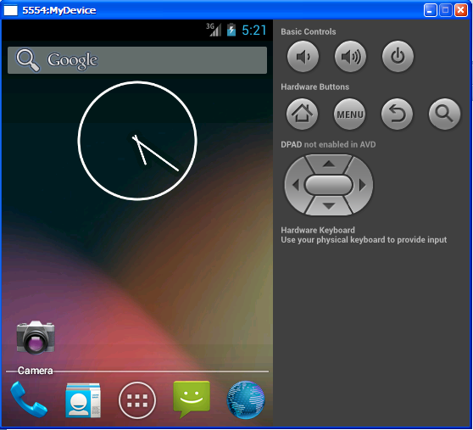
When the an Android Virtual Device (AVD) is launched, the user can see the AVD Emulator as follow:

Slide 10
Creating an Android Project
In Eclipse, select File > New > Android Application Project.
Open the Android folder, select Android Project and click Next.
Enter a project name (such as "MyFirstApp") and click Next.
Select a build target. This is the platform version against which you will compile your app.
Specify other app details, such as the:
Application Name: The app name that appears to the user. Enter "My First App".
Package Name: The package namespace for your app
Minimum SDK: You simply need to be sure that you don't use any APIs that require an API level greater than the minimum SDK version without first using some code to verify the device's system version.
Click Finish.

Slide 11
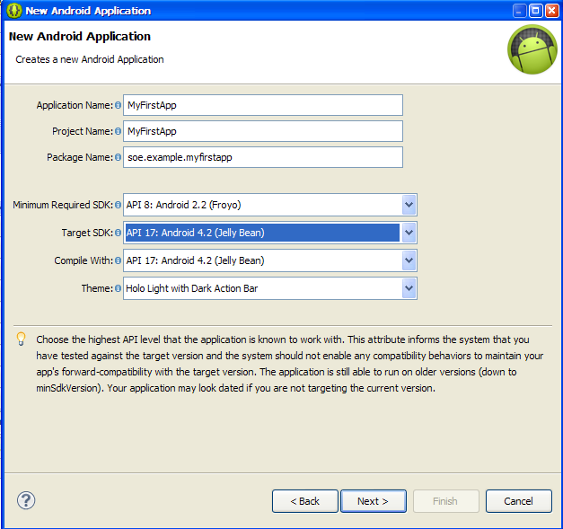

Slide 12
Directories and files in the Android project
AndroidManifest.xml
This manifest file describes the fundamental characteristics of the app and defines each of its components.
src/
Directory for your app's main source files. By default, it includes an Activity class that runs when your app is launched using the app icon.
res/
Contains several sub-directories for app resources. Here are just a few:
drawable-hdpi/
Directory for drawable objects (such as bitmaps) that are designed for high-density (hdpi) screens. Other drawable directories contain assets designed for other screen densities.
layout/
Directory for files that define your app's user interface.
values/
Directory for other various XML files that contain a collection of resources, such as string and color definitions.

Slide 13
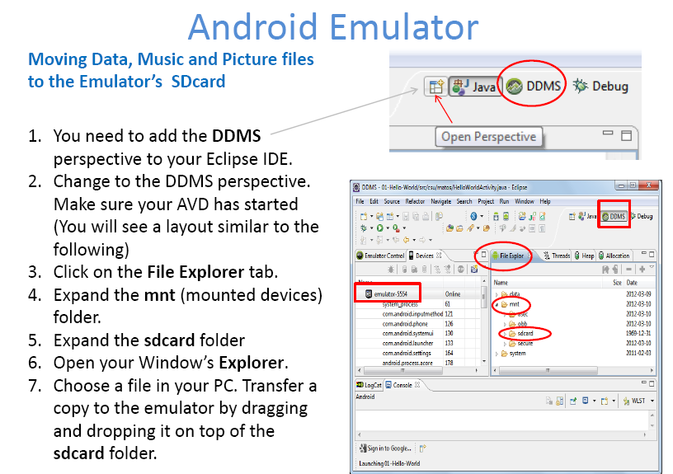

Slide 14
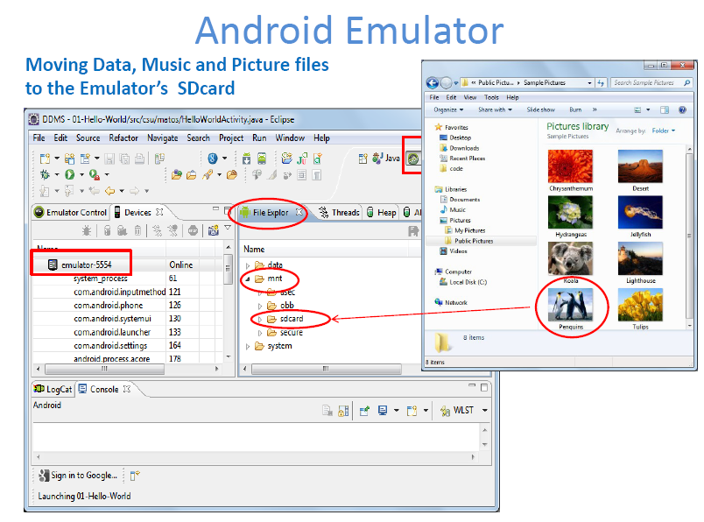

Slide 15
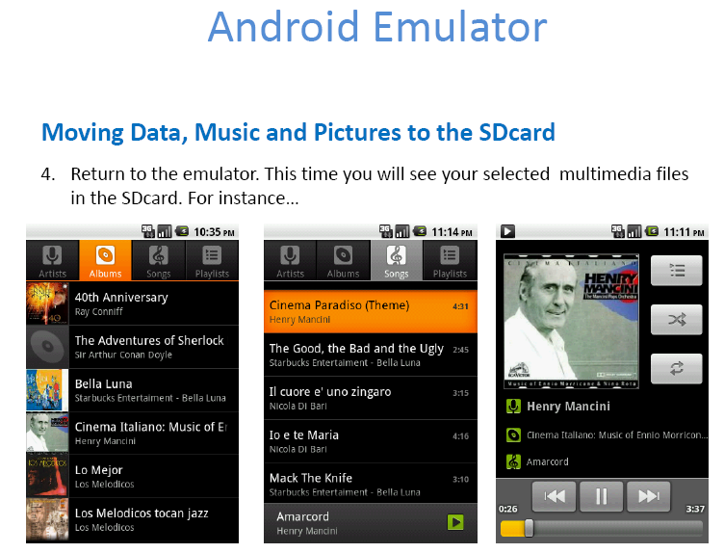

Slide 16
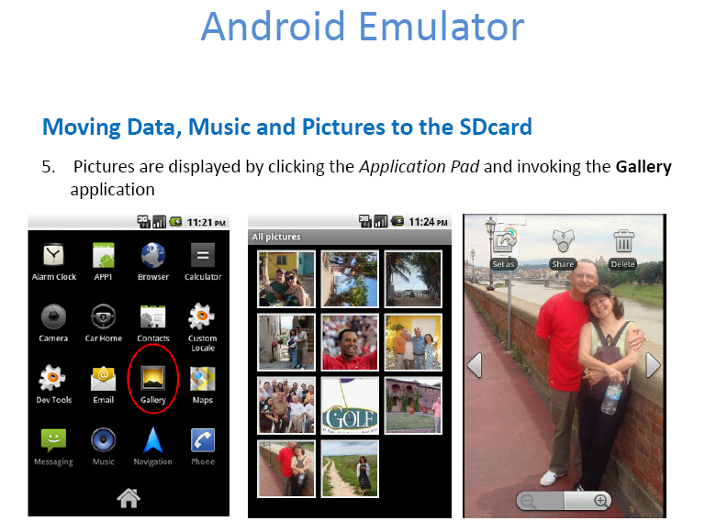

Slide 17
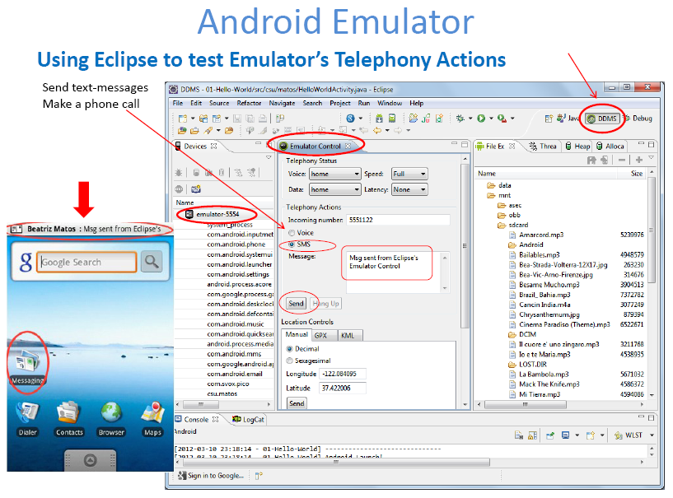

Slide 18
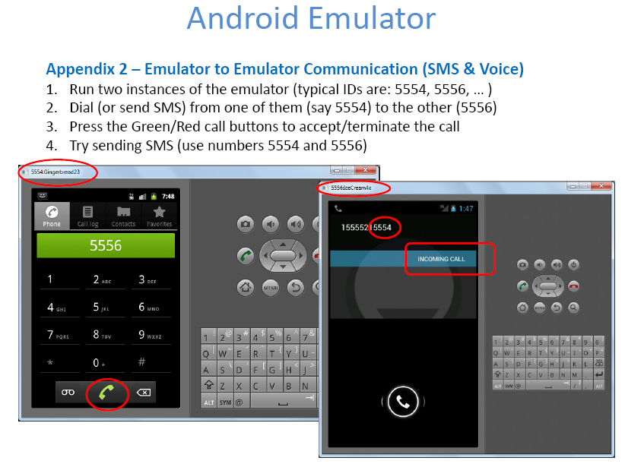

Slide 19
THANK yOU

